Slide 1
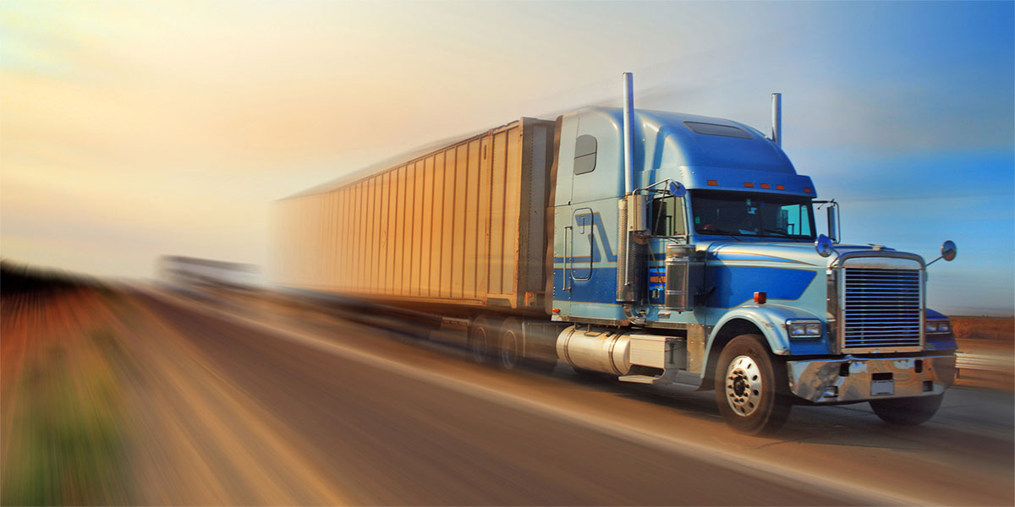
Big Data Analytics Project
TRUCK DRIVER RISK INDEX
By Group 3
Srija Kodali
Tej Kurani
Madhurima Madgula
Gunjan Mishra
Shweta Kishor Patel
Apoorva Patil
Aditya Savani

Slide 2
Introduction
The trucking industry in the US is consistently on the rise, even though newer and faster means of transport are being invented by the day. Regardless, this industry has gained great notoriety over the years.
Especially in the last couple of decades with a plethora of careless drivers of such large trucks, accidents are bound to happen. It is estimated that by 2030 it will become the fifth largest cause of death in the USA.
Our study, Truck driver risk index helps us to precisely identify contributing risk factors for drivers.

Slide 3
Business Scenario
We were pseudo acting managers of a fictional national trucking corporation, here to ensure that the truck drivers are complacent with the rules and regulations of the corporation.
We are addressing unsafe driving practices such as speeding, lane departing, etc as Business loop-holes and how to address them based on our analysis to ensure that they don’t put the corporation under insurance jeopardy.

Slide 4








Process Work Flow
Data from csv
Hadoop
Hive
Impala
R Studio
Tableau
Cloudera VM
Apache Pig
Connected from Impala using ODBC driver for exploratory data analysis
Geolocation and trucks.csv files
Moved files from VM local system to HDFS
All the tables synced
Moved files from local machine into VM local system
Creating tables in Hive for all csv files and more
Populated the riskfactor table
Connected to tableau using Rserve() and used for predicting risk factors

Slide 5
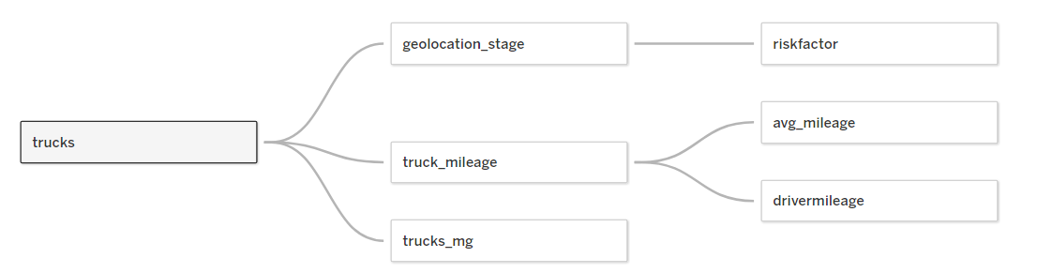
FLOW DIAGRAM
Important columns for modeling:
Velocity
Riskfactor_scale
Events
Mpg

Slide 6
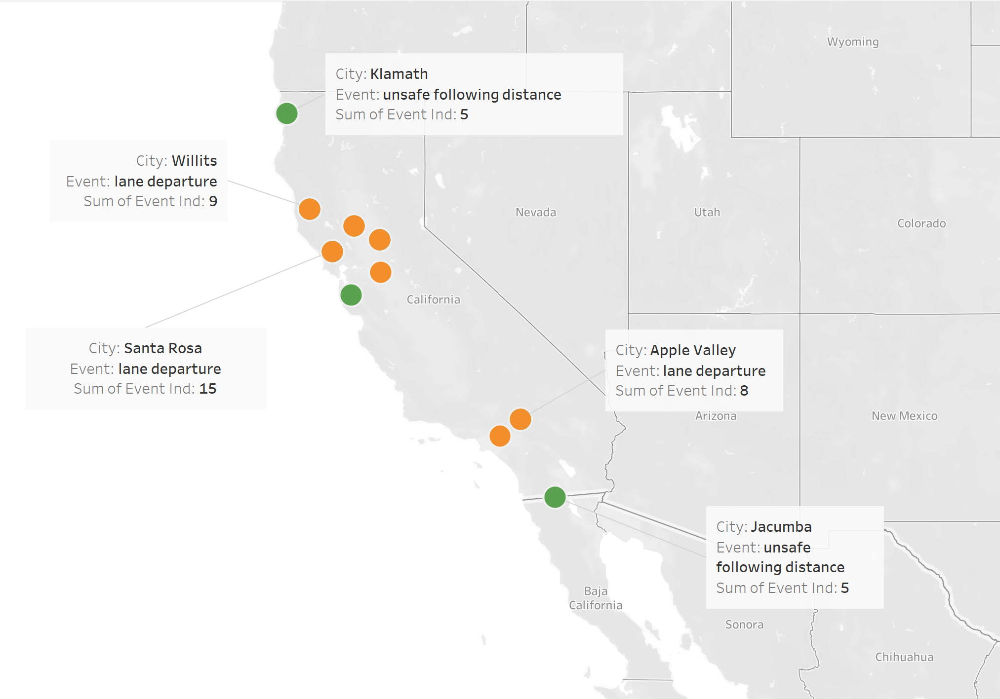
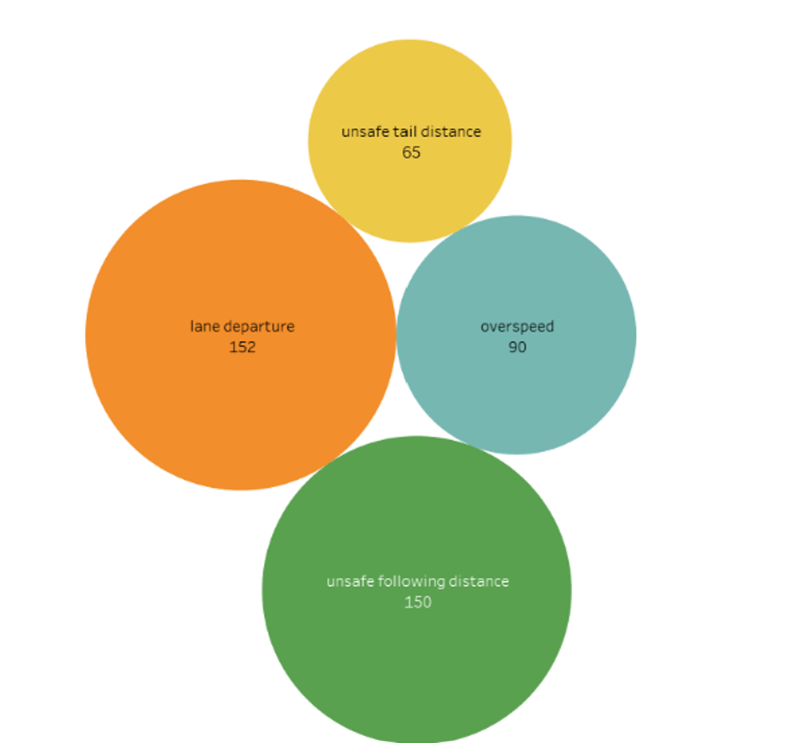
Event Analysis
From the data, the number of maximum event is happening due to lane departure- 152 and Unsafe following distance 150.
High frequency locations of such events are listed out.
Recommendations-
Specific guidelines focused on lane departure and unsafe following distance.
Trucks may be equipped with devices that will enforce driver to follow lanes and safe distance
Notes:
For events, lane departure & unsafe following distance- Max number- 152

Slide 7
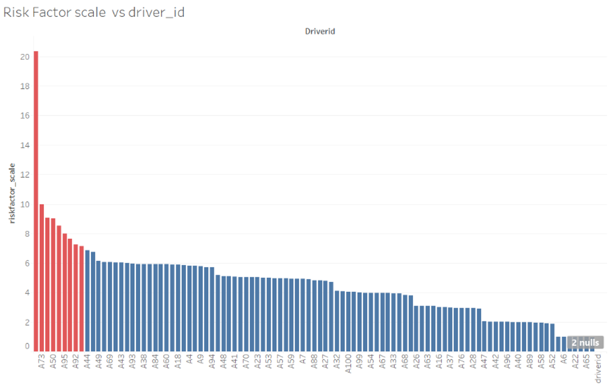
Driver's Analysis
Driver Id A97 has highest risk factor of 20.35.
By scaling risk -factor, Drivers crossing risk factor threshold of 7 are A73, A50,A5,A92, A35 and others.
They are 9 in total.
Recommendations:
To avoid events , drivers with highest risk factor need to focused.

Slide 8
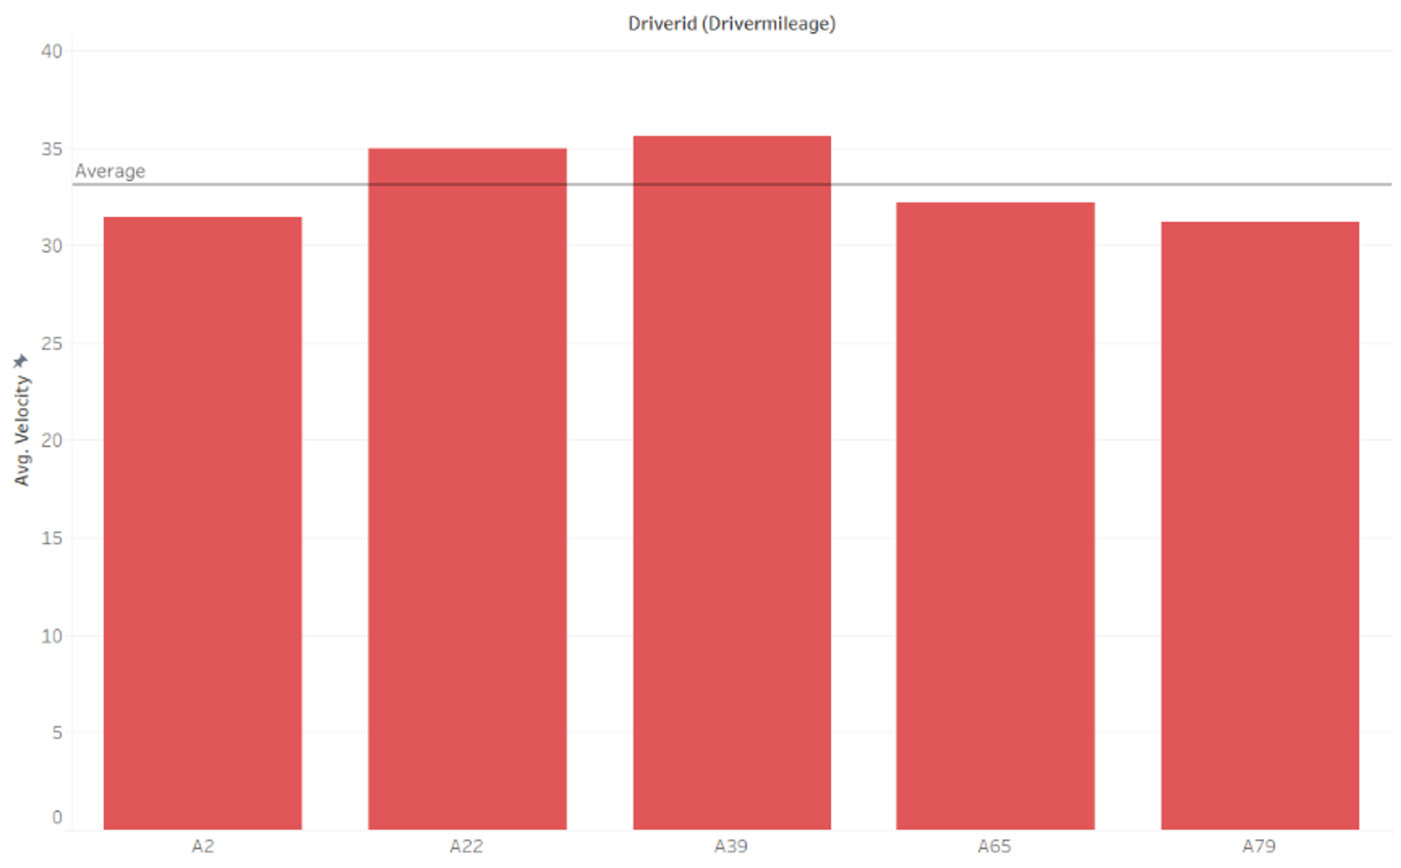
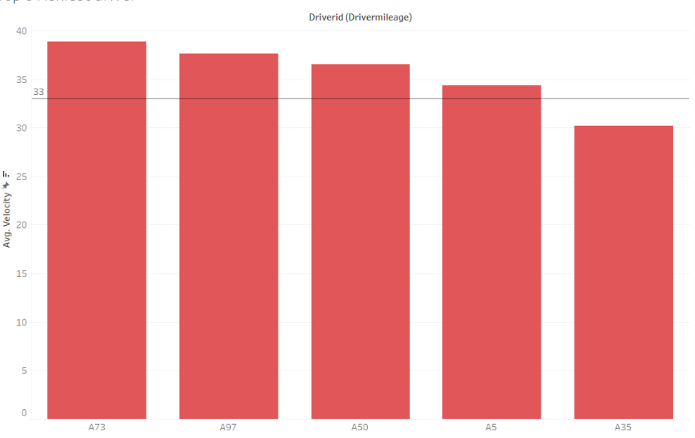
Speed Analysis
Top 5 safest driver's average speed is 33 .
From analysis we can see that from riskiest top 5 , 4 driver's average velocity is more than 33.
Recommendations:
Monitoring of speed of drivers so they are within limit.
Regulations on speed policy
Top 5 safest drivers
Top 5 riskiest drivers

Slide 9
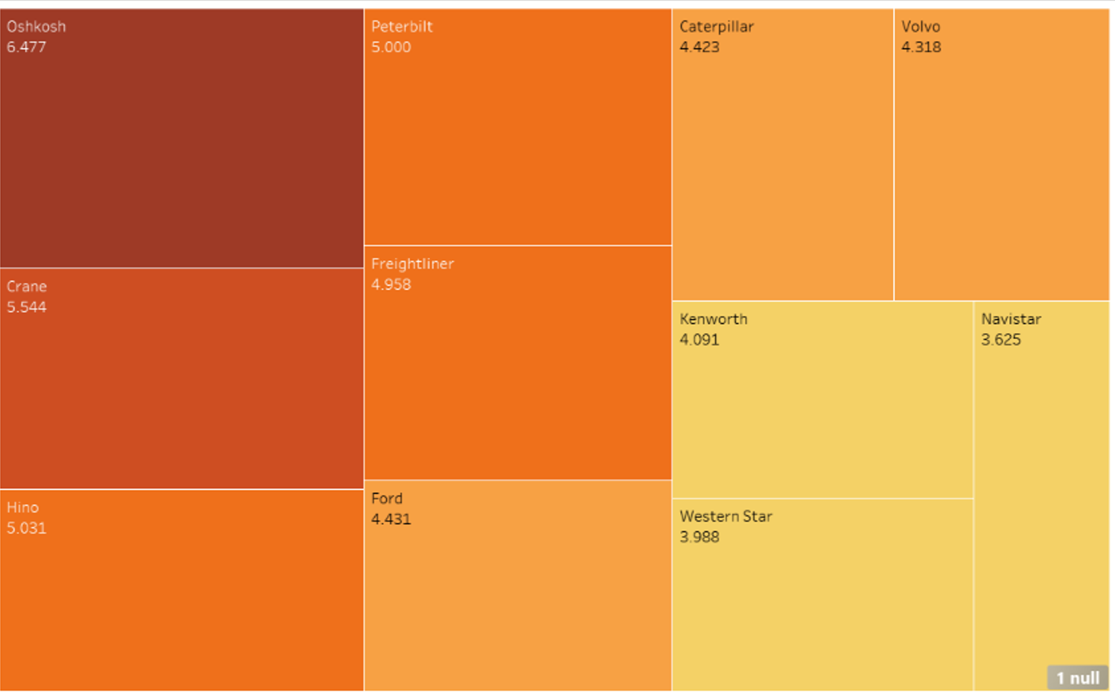
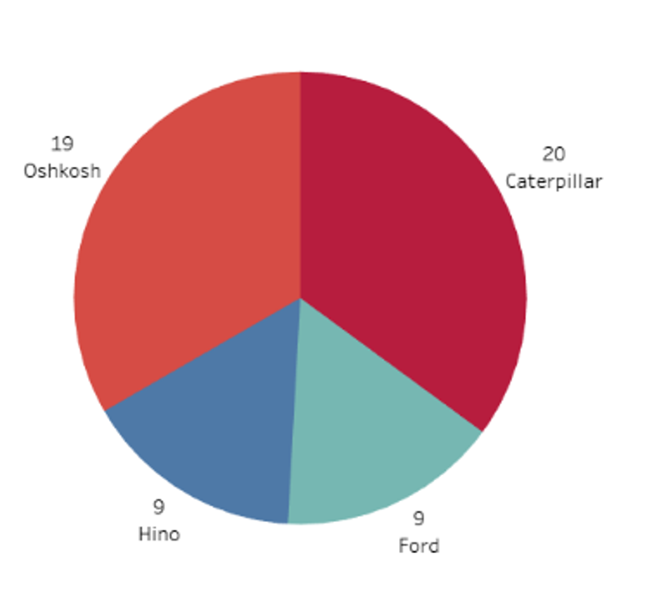
Model Wise Analysis
From the average risk factor analysis of all models, Oshkosh has the highest risk factor.
From top 5 riskiest drivers ,Oshkosh and Caterpillar indicating highest number of events.

Slide 10
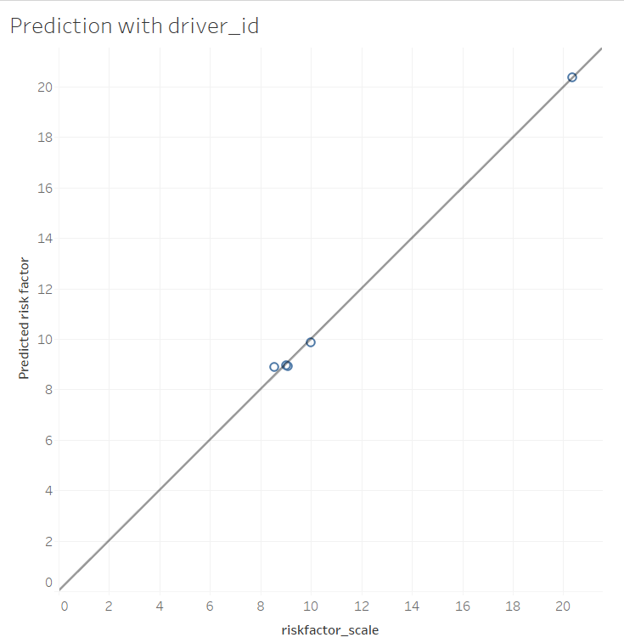
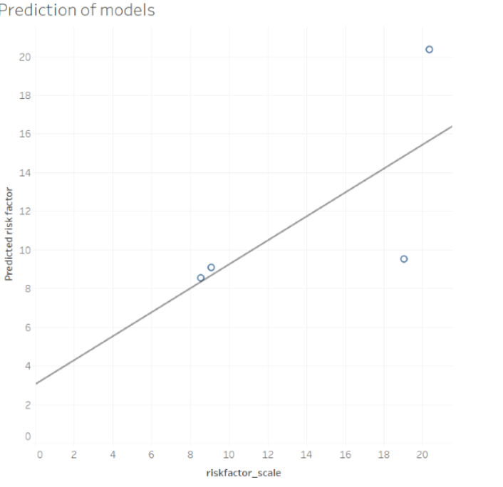
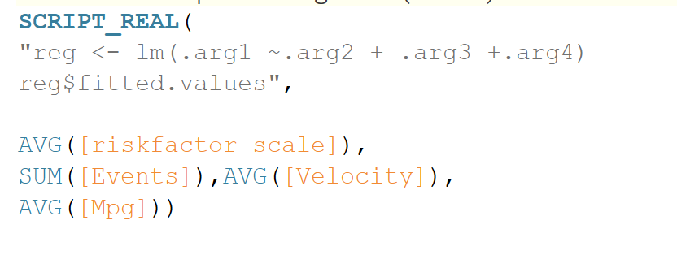
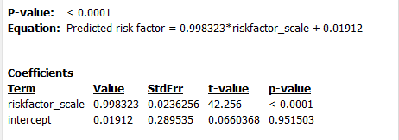
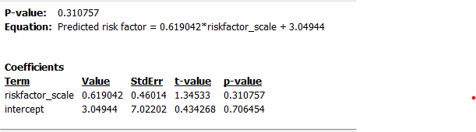
Risk Factor Prediction
Predicted risk factor for 5 riskiest driver and also for their models.

Slide 11
Conclusion
The risk factor was determined not only by the driver, but also by external factors such as truck model, geographic location, and total miles driven.
The type of abnormal events depend on the geographical locations.

Slide 12
Challenges & Outcomes
Networking: We found it hard to communicate initially as none of us knew each other & had different timings. But as we started the project, we had a good time and all 7 of us got along well.
Analytical Tools: Many of our team members weren’t proficient in R & Tableau, so we found it hard initially. But as we worked along, we had a good learning curve and we started to make visualizations well.

Slide 13
THANK YOU
TRUCK DRIVER RISK INDEX

